Slide 1


Nature
Prediction on traffic level
of NewYork city
Course: STAT4650 – Machine Learning
Professor: Dr. Yue Gao
Date: April 18th, 2025
Team :
Jinbei Ke
Feroz Shaik
Kuriappan Morris
-

Slide 2


Introduction
Weather impact
NYC traffic
Machine learning
Better city planning

Slide 3

To what extent can weather variables (e.g., temperature, precipitation, wind speed) predict traffic levels in New York City?
Which machine learning model accurately classify traffic volume levels in New York City based on time based variables and weather data
What is the relationship between severe weather events and reductions or increases in NYC traffic volume?
Research Questions

Slide 4
Data Description
Key Variables:
Direction: Traffic direction
(e.g., NB = Northbound, SB = Southbound)
Traffic Volume: Hourly number of vehicles
Traffic_level: Traffic category (Low / Medium /High)
Traffic_level_num: Numeric encoding of traffic level (0 / 1 / 2)
SegmentGroup_High: Major roads with consistently high traffic
SegmentGroup_Medium: Roads with moderate traffic flow
Traffic Data
Source: NYC Open Data (processed and merged with weather data)
Sample Size: 123,912 records

Slide 5
Data Description
Key Variables:
temperature_2m (°C): Temperature at 2 meters height
precipitation (mm): Total precipitation
rain (mm): Rainfall amount
cloudcover (%): Overall cloud coverage
cloudcover_low (%): Low-altitude cloud cover
cloudcover_mid (%): Mid-altitude cloud cover
cloudcover_high (%): High-altitude cloud cover
windspeed_10m (km/h): Wind speed at 10 meters
winddirection_10m (°): Wind direction in degrees
Weather Data
Source: Kaggle – NYC Weather 2016–2022 Dataset
Sample Size: 123,912 records (matched with traffic timestamps)

Slide 6

Methods
1. Data Cleaning & Preprocessing
2.Feature Engineering
3. Model Selection
4.Model Tuning & Evaluation
Remove missing and outlier values
Merge data
Create traffic level labels
Encode direction)
Extract time
Logistic Regression
Random Forest
XGBoost
KNN
Evaluate models: Accuracy
Precision
Recall

Slide 7
Logistic Regression
Home
About
Content
Others
Variable | Coefficient | p-value | Significance
Hour | -1.189 | 0 | ***
precipitation (mm) | -0.3195 | 0.001 | **
cloudcover (%) | -0.0703 | 0.046 | *
cloudcover_mid (%) | 0.265 | 0 | ***
cloudcover_high (%) | 0.0698 | 0 | ***
windspeed_10m (km/h) | 0.0498 | 0 | ***
dayofweek | -0.1233 | 0 | ***
month | -0.1548 | 0 | ***
is_weekend | 0.2959 | 0 | ***
Direction_SB | 0.0547 | 0 | ***
Direction_WB | 0.0462 | 0 | ***
SegmentGroup_Medium | 1.1586 | 0 | ***
SegmentGroup_High | 1.8205 | 0 | ***
Hour, precipitation, cloudcover, windspeed, day of the week, month, Direction, Segment Groups are statistically significant
Cross validation accuracy of 60.54

Slide 8
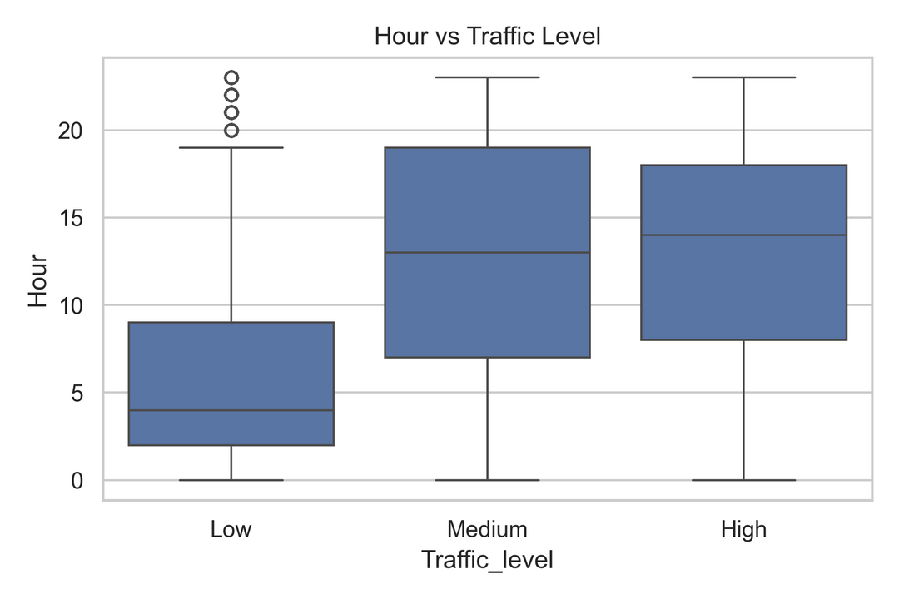
Descriptive Analysis
Traffic Peaks in Afternoon:
Low traffic occurs mostly in early hours (median ~4 AM), while medium and high traffic are spread throughout the day, peaking around 1–2 PM.

Slide 9
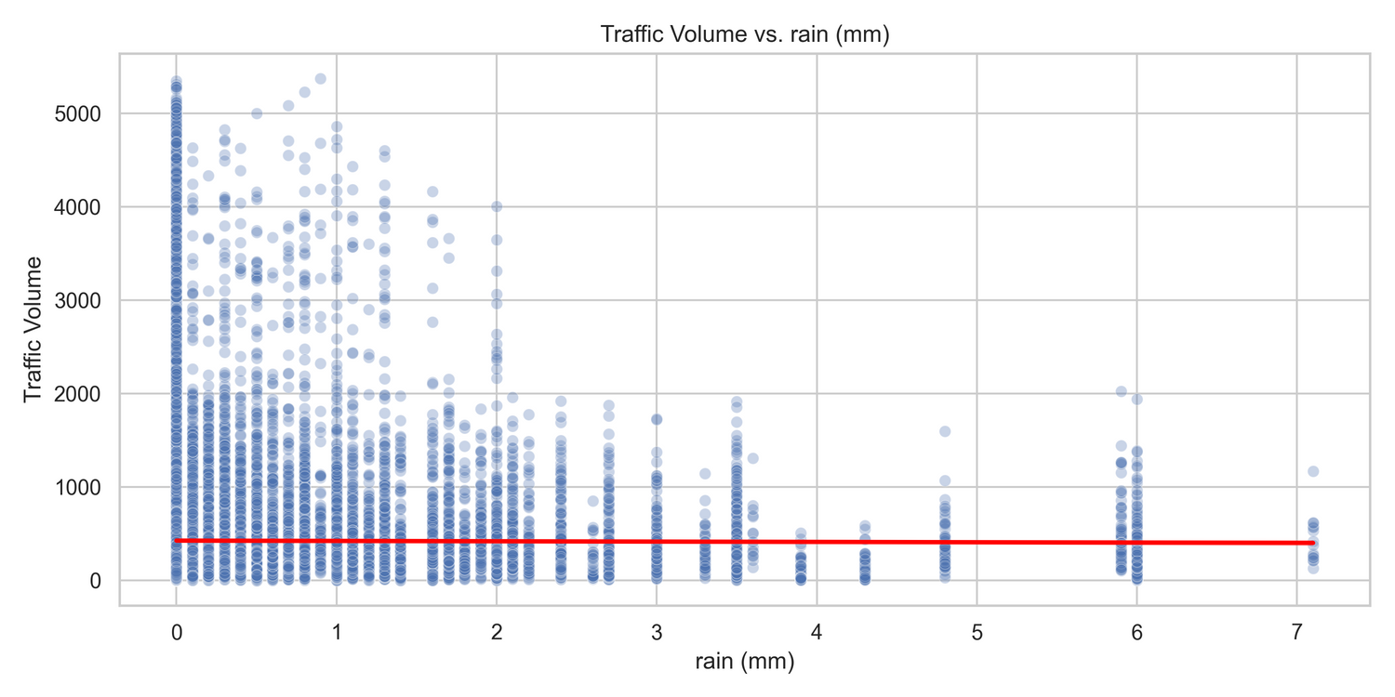
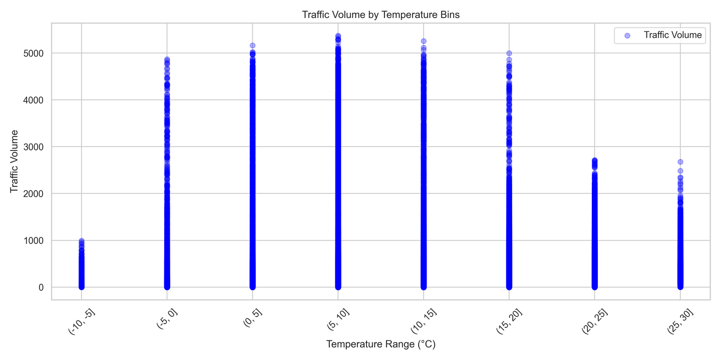
Descriptive Analysis
Traffic Peaks in Mild Temperatures:
Traffic volume is highest between 0°C and 20°C, indicating that moderate temperatures are associated with increased traffic activity.
Rain reduces Traffic Volume:
As rainfall increases, traffic volume generally decreases, indicating a negative correlation between rain and traffic activity.

Slide 10
Logistic Regression
Class | Precision | Recall | F1-Score
High | 0.62 | 0.73 | 0.67
Low | 0.52 | 0.36 | 0.42
Medium | 0.7 | 0.75 | 0.72
✅ High Class:
Strong recall (73%) and good precision (62%)
✅ Medium Class:
Highest recall (75%) and precision (70%)
⚠️ Low Class:
Low recall (36%) and precision (52%)

Slide 11
Random Forest
Traffic_level ~ SegmentGroup_High+ SegmentGroup_Medium+ Hour+ Month+ DayOfWeek+ Is_Weekend+ Precipitation (mm)+ Rain (mm)+ Temperature at 2m (°C)+ Cloudcover Low (%)
Traffic Level | Precision | Recall | F1-Score
High | 0.72 | 0.75 | 0.73
Low | 0.82 | 0.58 | 0.68
Medium | 0.76 | 0.85 | 0.8
High Traffic has the a high recall (0.75)
Low Traffic has the highest precision (0.82)
Medium Traffic has a strong recall (0.85
Cross Validation Accuracy of 76

Slide 12
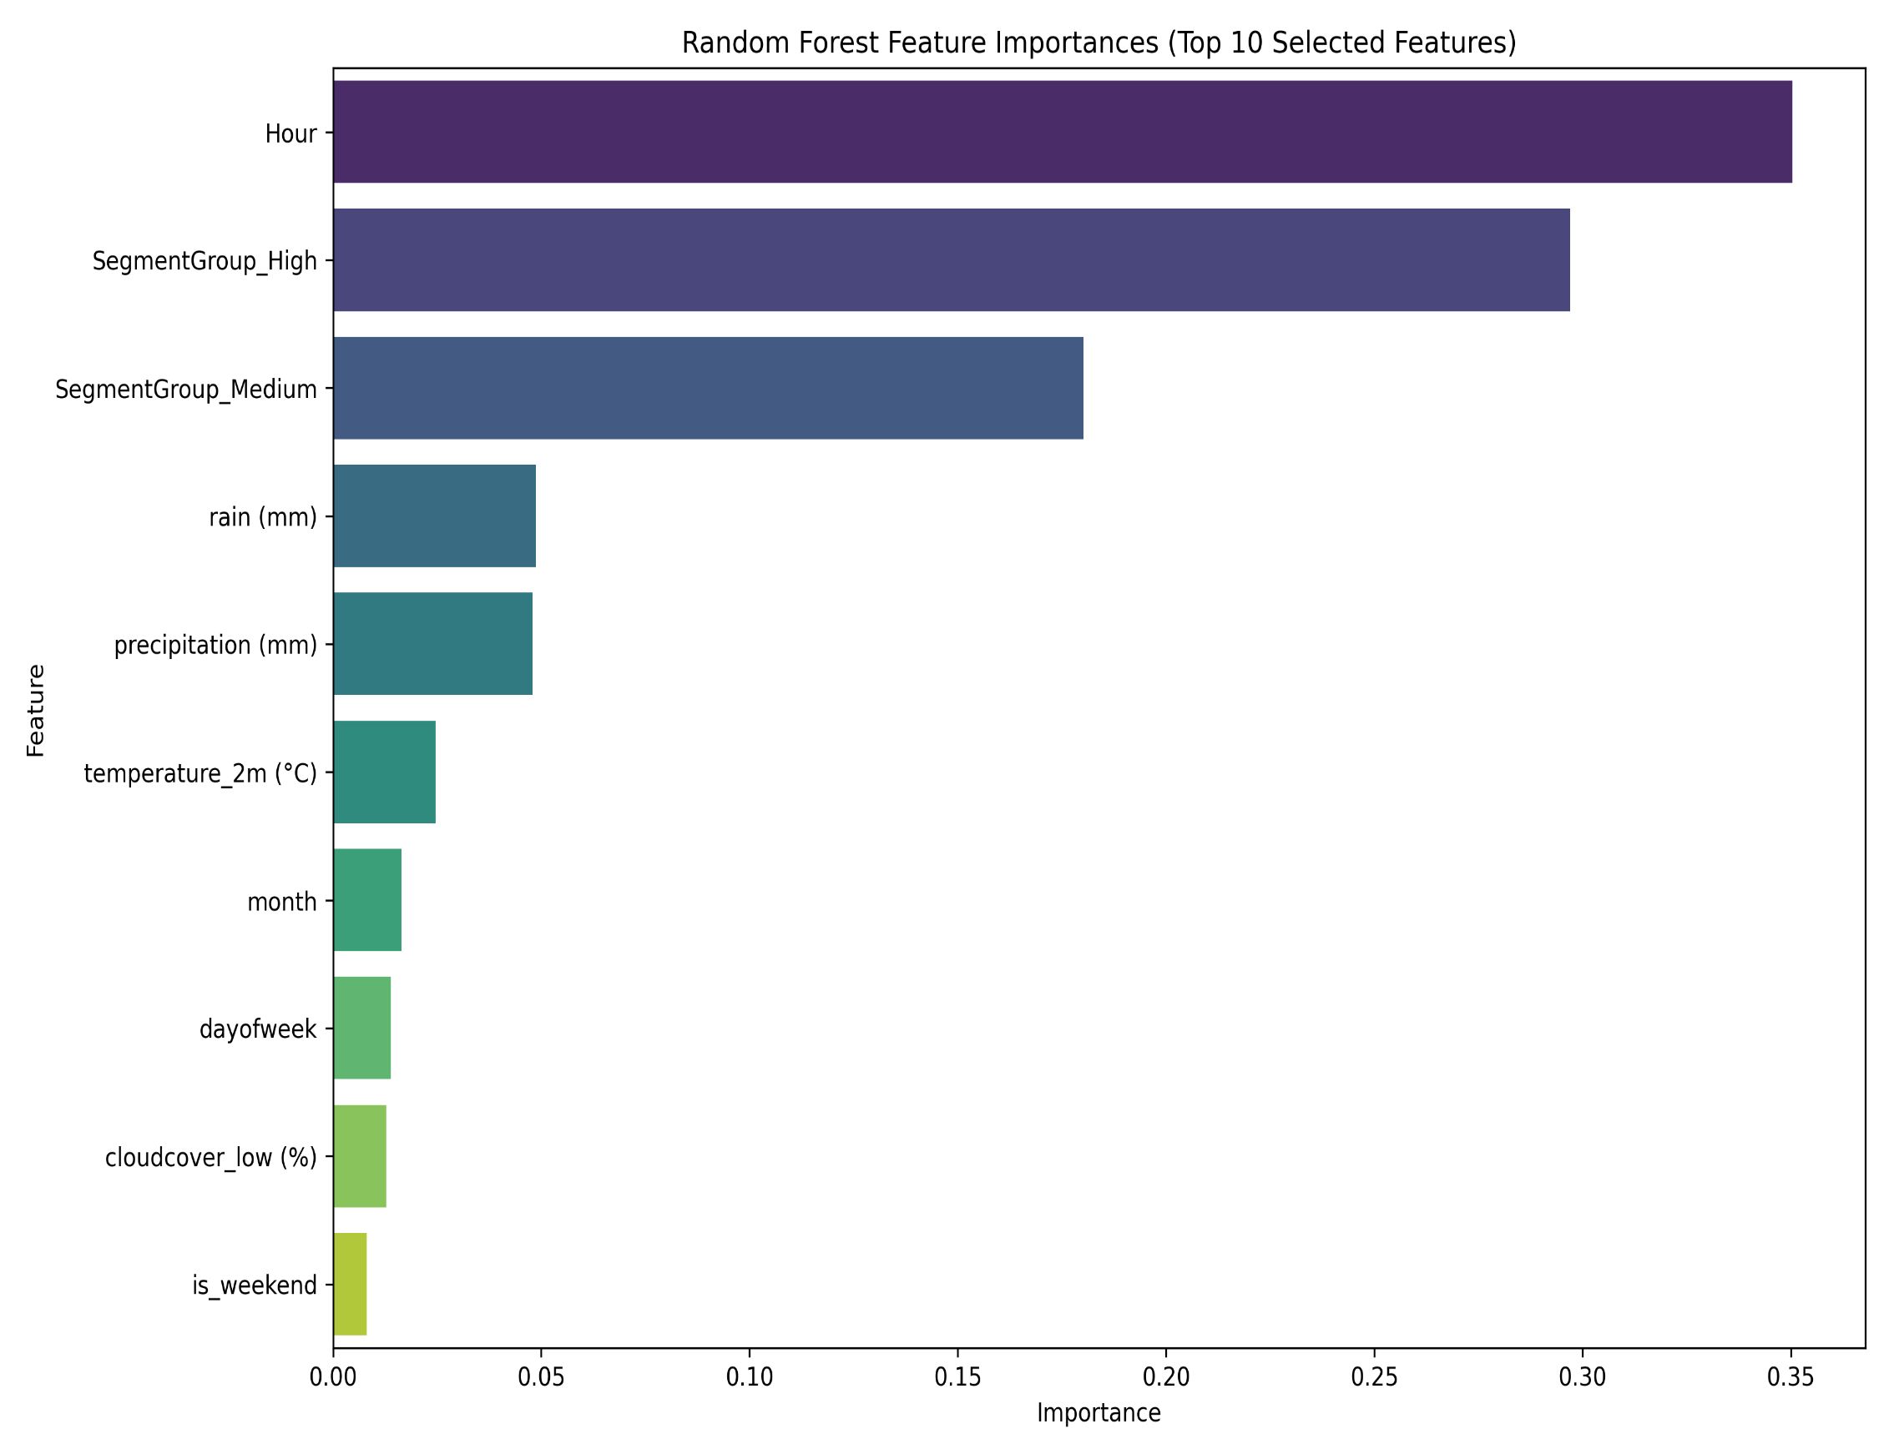
Random Forest
Hour, Segment Groups and Rain are the top features identified
Followed by precipitation and temperature

Slide 13
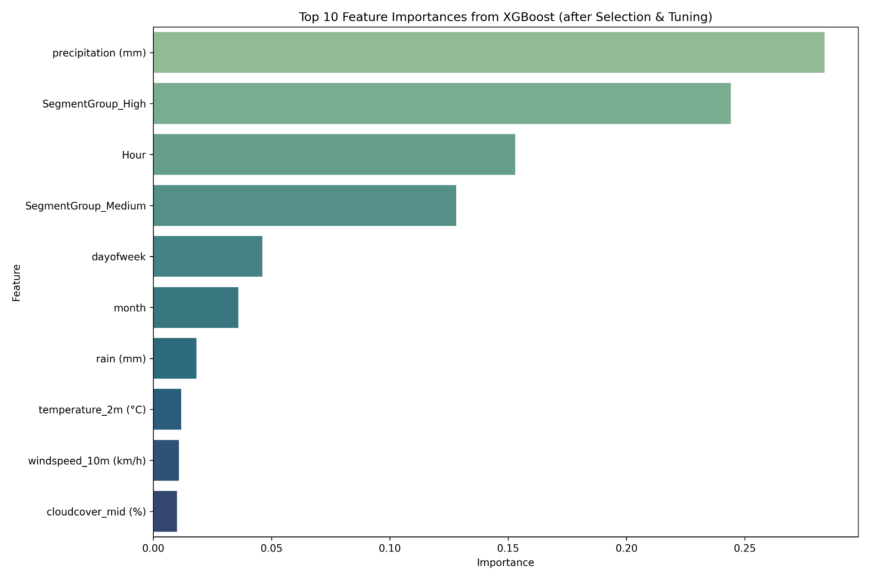
XG Boost
Traffic Level | Precision | Recall | F1-Score
High | 0.72 | 0.75 | 0.73
Low | 0.82 | 0.58 | 0.68
Medium | 0.76 | 0.85 | 0.8
High Traffic has the a high recall (0.75).
Low Traffic has the highest precision (0.82)
Medium Traffic has a strong recall (0.85
Cross Validation Accuracy of 77
Precipitation, Segment Groups(High and Medium) and Hour are the top 3 important features
Cloud cover is the least influential feature

Slide 14
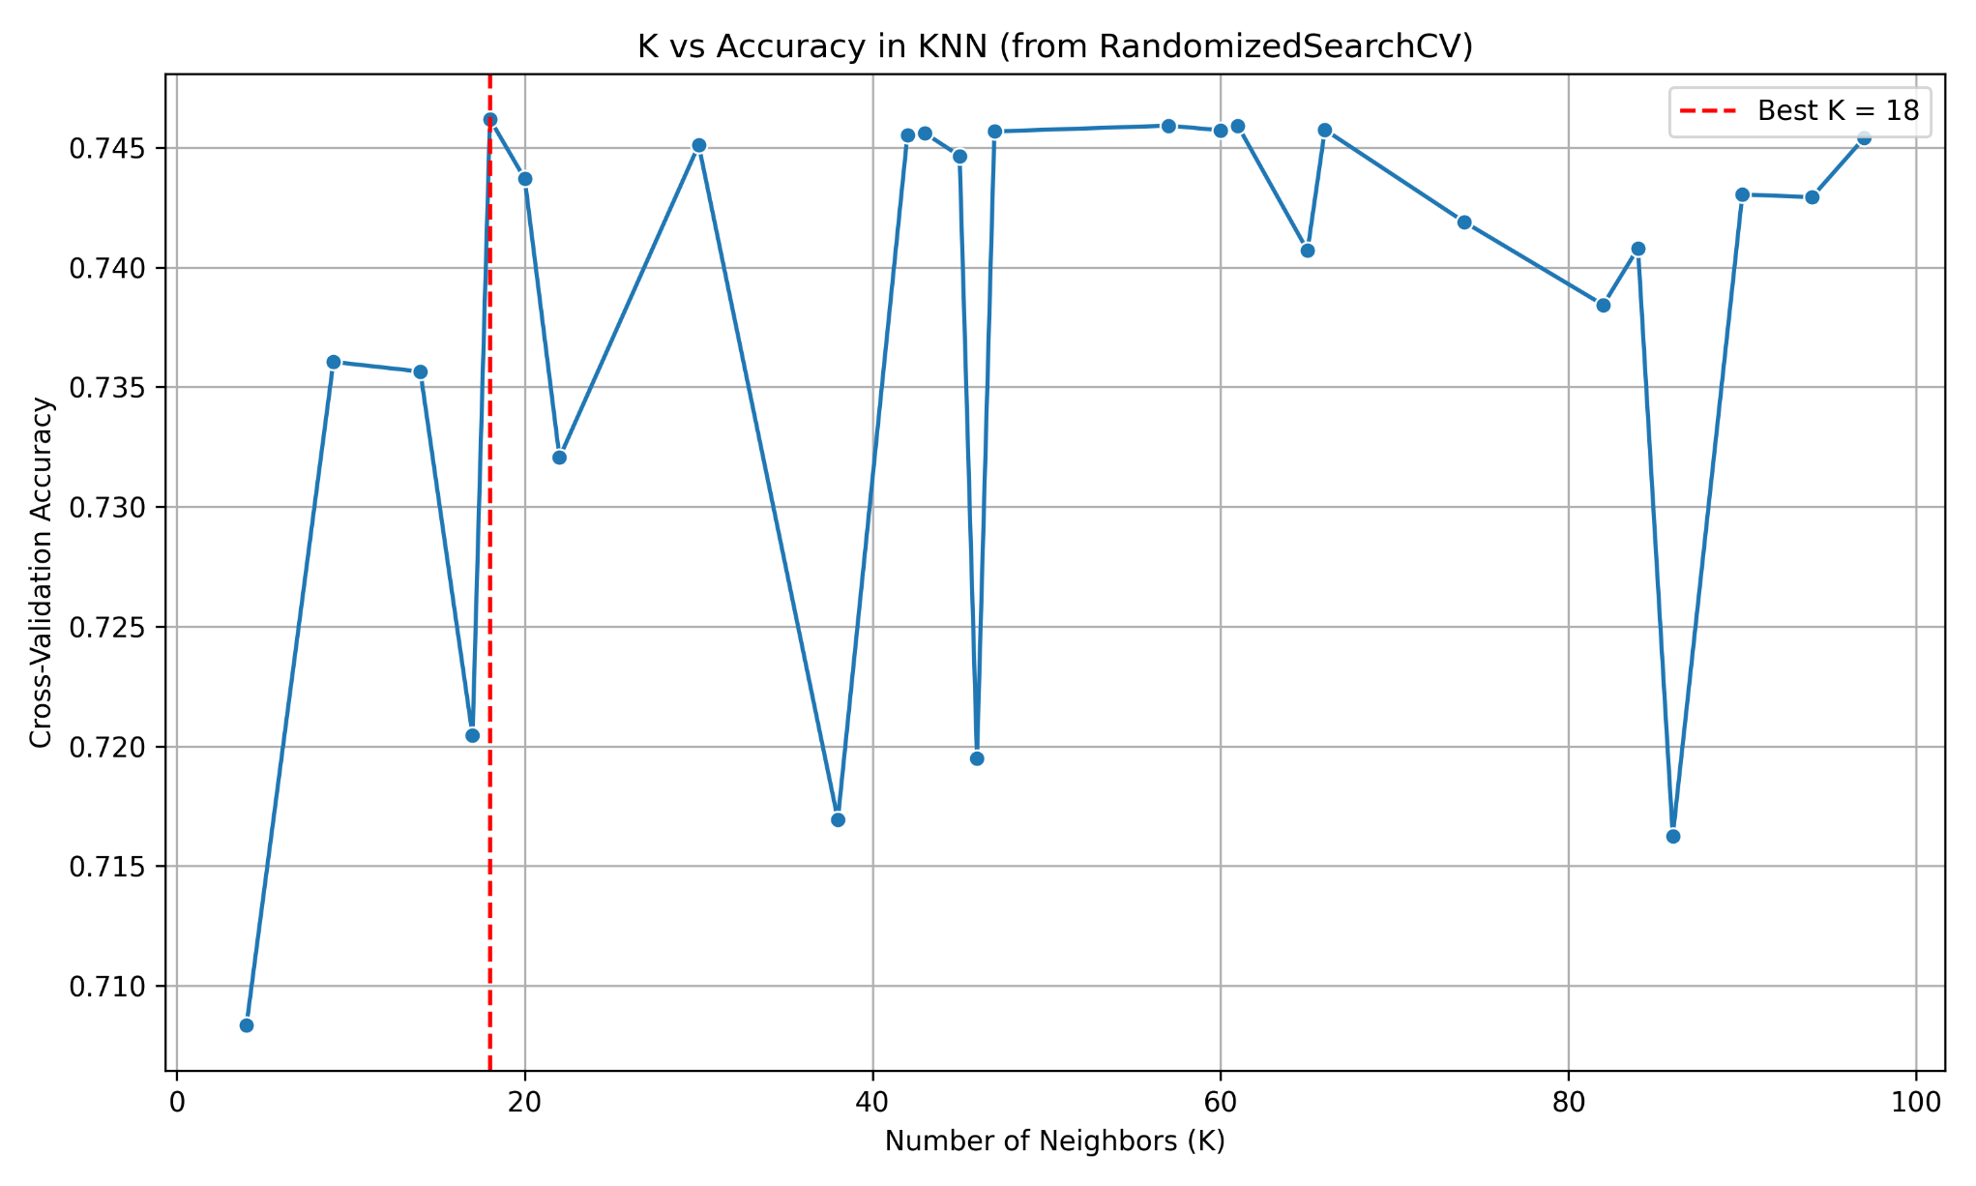
KNN – Hyperparameter tuning
K = 18 gave us the best accuracy
of approximately 75

Slide 15
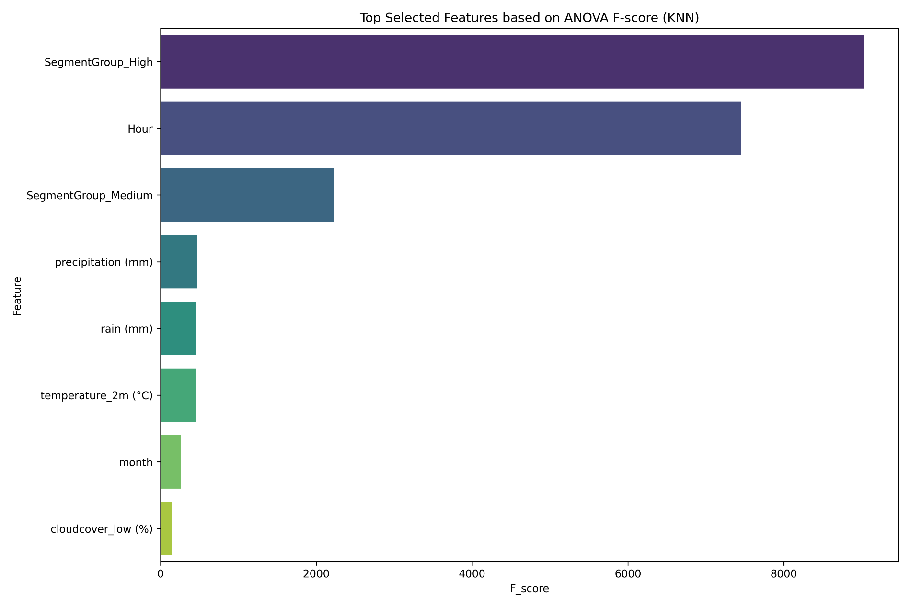
KNN
Traffic Level | Precision | Recall | F1-Score
High | 0.72 | 0.74 | 0.73
Low | 0.75 | 0.62 | 0.68
Medium | 0.76 | 0.82 | 0.79
High Traffic has the a high recall (0.74).
High Traffic has a strong recall (0.85)
Cross Validation Accuracy of 76
Precipitation, Segment Groups(High and Medium) and Hour are the top 3 important features

Slide 16

Results
1.XGBoost had the highest accuracy (77%)
2.Random Forest and KNN also performed well (75–76%)
3.Logistic Regression served as a baseline (60.5% accuracy)
4.Hour, Segment Groups, and Rain were top predictive features
5.Medium traffic level was most accurately classified by all models

Slide 17

Discussion
Findings: Weather features explain traffic variation well
Recommendation: Integrate models into city transport dashboards
Innovation: Merge real-time weather & road sensor data
Contribution: Open-source framework for traffic prediction
Applications: City traffic control, public safety alerts, smart commuting apps

Slide 18

Conclusion
Machine learning models like Random Forest and XGBoost worked well.
The model can help cities plan better for traffic during bad weather.
It could be used for smart traffic lights, emergency alerts, and bus schedules.

Slide 19
Thank You.
-

Slide 20

Q & A
-

